Slide 1

HR Insights Pro
Employee Retention & Performance Analytics
A data-driven project leveraging Python, SQL, and Power BI to uncover key factors influencing employee attrition, satisfaction, and performance across 1,470 employees.

Slide 2

Dataset Overview
Scale
Coverage
1,470 employees across 35 data columns
Demographics, job details, performance, compensation, and work conditions
Source
IBM HR Analytics Employee Attrition Dataset (Kaggle)

Slide 3
Data Preparation & Engineering
01
02
Data Loading & Exploration
Cleaning & Standardization
Imported HR dataset using pandas; inspected structure, data types, and summary statistics.
Verified no missing data; converted column names to lowercase with underscores for SQL integration.
03
04
Feature Engineering
Database Integration
Created age_group (Young, Adult, Mid-Age, Senior) and experience_level (New through Veteran) categories.
Exported cleaned data to PostgreSQL using SQLAlchemy for SQL-based analysis and Power BI visualization.

Slide 4

Attrition Patterns Uncovered
Overall Attrition Rate
16.12% (237 of 1,470 employees)
Highest Risk Groups
Overtime workers: 30.53%
New employees: 34.88%
Sales dept: 20.63%
20+ km commute: 22.06%

Slide 5
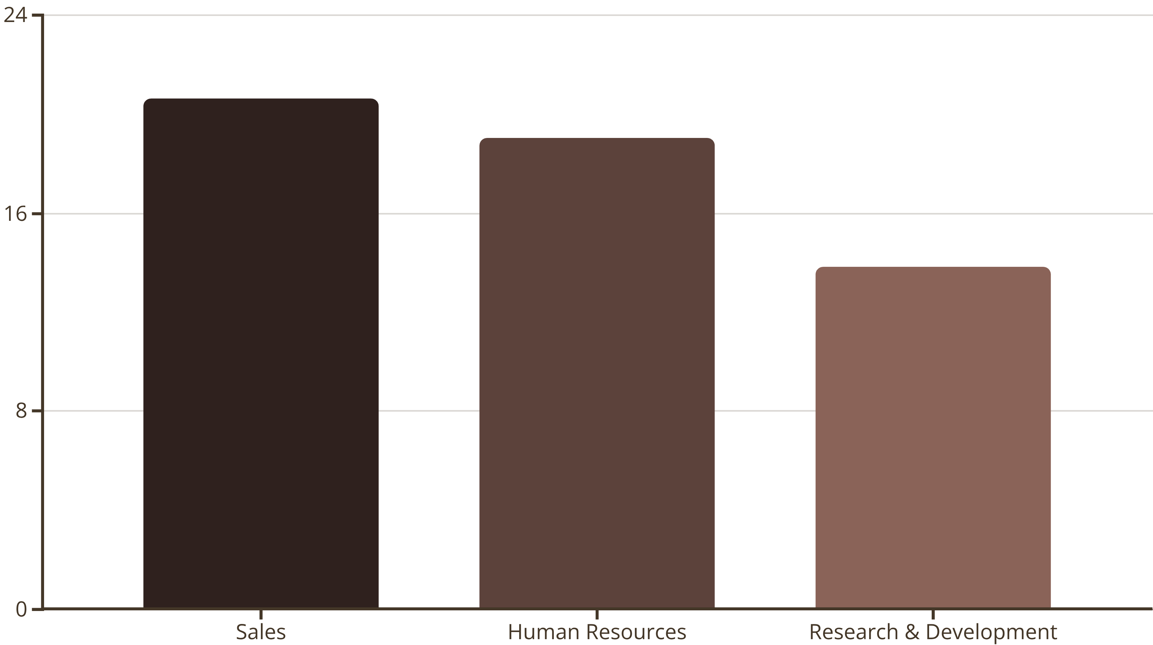
Department & Role Analysis
Sales department shows highest attrition at 20.63%. Top departing roles include Healthcare Representatives (7,529 avg income) and Laboratory Technicians (3,237 avg income), indicating compensation gaps in critical positions.

Slide 6




Satisfaction & Compensation Impact
Job Satisfaction Level 1
Job Satisfaction Level 4
1
2
22.84% attrition
11.33% attrition
Overtime: No
4
3
Overtime: Yes
10.44% attrition
30.53% attrition
Low satisfaction and overtime work are primary attrition drivers. Salary hikes show minimal impact on retention, suggesting non-monetary factors dominate employee decisions.

Slide 7

Experience & Distance Insights
Attrition by Experience Level
Attrition by Commute Distance
New employees: 34.88%
Intermediate: 18.08%
20+ km: 22.06%
Experienced: 11.07%
11-20 km: 20.00%
Veteran: 8.70%
6-10 km: 14.47%
0-5 km: 13.77%

Slide 8

Power BI Dashboard Capabilities
Department-wise Analysis
Attrition and salary distribution by department
Overtime Impact
Real-time tracking of work-life balance effects
Satisfaction Trends
Job satisfaction vs attrition correlation
Dynamic Filters
Department, gender, age group, experience level

Slide 9
Strategic Recommendations
1
Mentorship & Recognition
Launch programs for critical roles to reduce attrition in high-risk departments.
2
Flexible Schedules
Minimize overtime stress; offer hybrid work for long-commute employees.
3
Pay Equity Alignment
Address compensation gaps between roles; align salaries with performance.
4
Career Development
Build structured upskilling frameworks to support new employee retention.
5
Engagement Initiatives
Regular satisfaction surveys and wellness programs to boost morale.

Slide 10

Professional Impact
20-25%
100%
7
Potential Attrition Reduction
Data-Driven Decision Making
Key Insights Identified
Achievable through targeted retention strategies
Strengthened HR transparency and workforce planning
Actionable recommendations for continuous optimization
This project transformed HR analytics into a strategic asset, enabling leadership to monitor attrition KPIs, assess workforce health, and implement data-driven retention strategies for sustainable organizational growth.

